Slide 1
RecallApp
Wang Zhang, James Clark, Tirumala Reddy Konireddy, Jagadish Tirumalasetty

Slide 2
Recall Data
4 Independent Sources
Consumer Public Safety Commission
National Highway Traffic Safety Administration
Food and Drug Administration
US Department of Agriculture

Slide 3
Lucky for us - they feed one source
http://api.usa.gov/recalls/search.json
{"success":{"total":26153,"results":
That’s great, select all, then process… right?

Slide 4
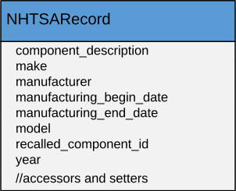
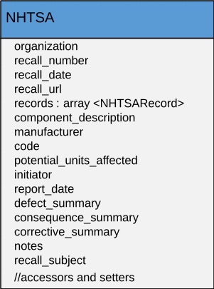
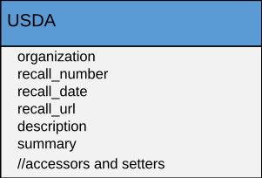
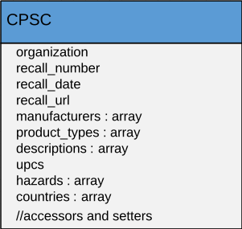
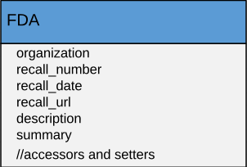
But wait … what’s this !?!!
… data in different shapes and sizes

Slide 5
Generalize and Classify Separately
Example
classifiable = nhtsa.concatenate(
description,
defect_summary,
consequence_summary
);

Slide 6
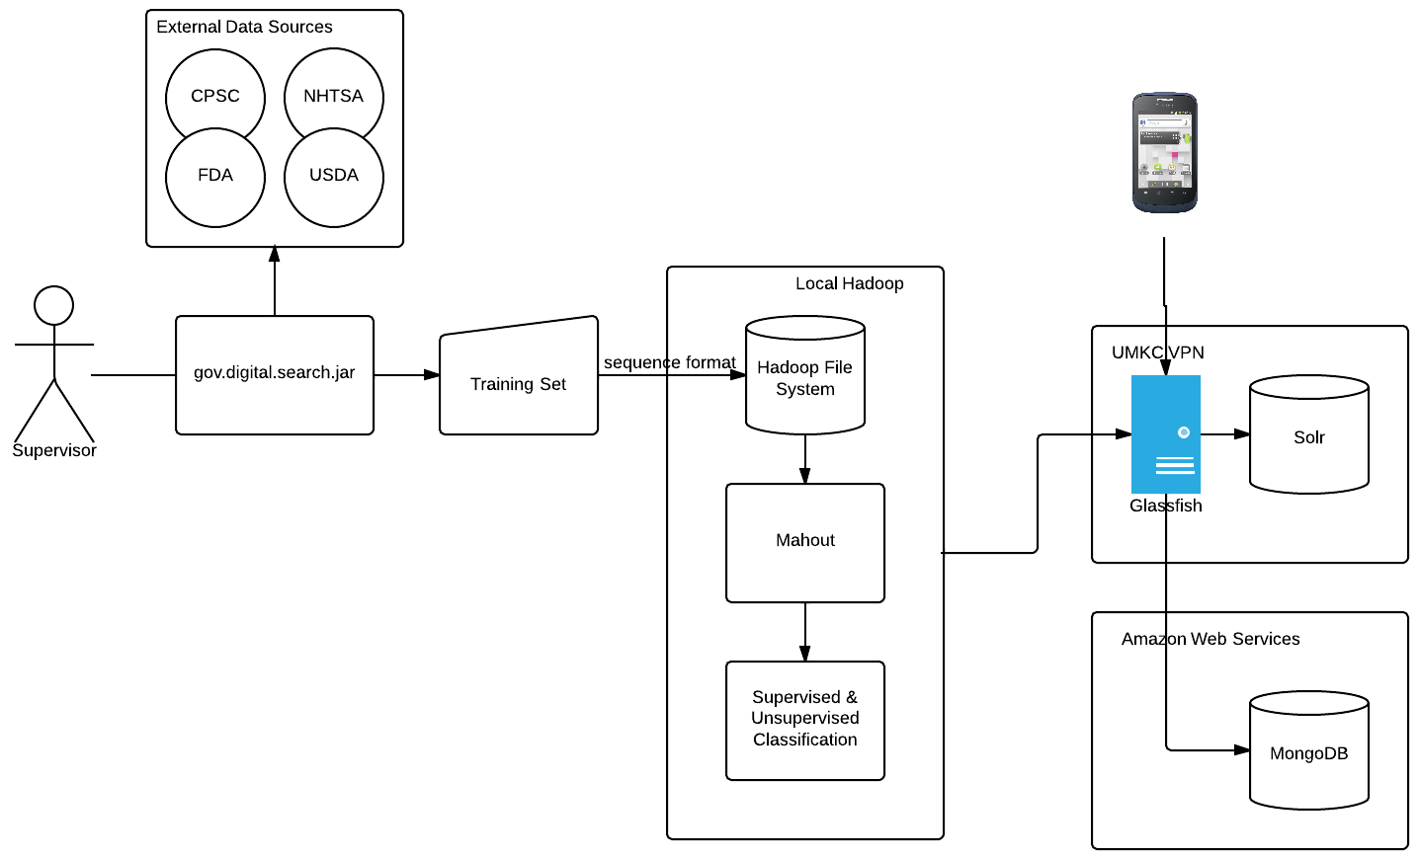
Application Architecture

Slide 7
Future Work
What does social media reveal about recalled products?
Can we measure how severe a recall is based on user comments in social feeds?
There is more related data
Safetyfirst.gov reveals more recall apps and data feeds, including user submitted complaints and reports.

